Slide 1
Vector Spaces
VECTOR SPACES AND SUBSPACES

Slide 2




VECTOR SPACES AND SUBSPACES
Definition: A vector space is a nonempty set V of objects, called vectors, on which are defined two operations, called addition and multiplication by scalars (real numbers), subject to the ten axioms (or rules) listed below. The axioms must hold for all vectors u, v, and w in V and for all scalars c and d.
    The sum of u and v, denoted by , is in V.
    .
    .
    There is a zero vector 0 in V such that
    .

Slide 3





VECTOR SPACES AND SUBSPACES
    For each u in V, there is a vector in V such that .
    The scalar multiple of u by c, denoted by cu, is in V.
    .
    .
    .
    .
Using these axioms, we can show that the zero vector in Axiom 4 is unique, and the vector , called the negative of u, in Axiom 5 is unique for each u in V.

Slide 4





VECTOR SPACES AND SUBSPACES
For each u in V and scalar c,
----(1)
----(2)
----(3)
Example 1: Let V be the set of all arrows (directed line segments) in three-dimensional space, with two arrows regarded as equal if they have the same length and point in the same direction. Define addition by the parallelogram rule, and for each v in V, define cv to be the arrow whose length is times the length of v, pointing in the same direction as v if and otherwise pointing in the opposite direction.

Slide 5
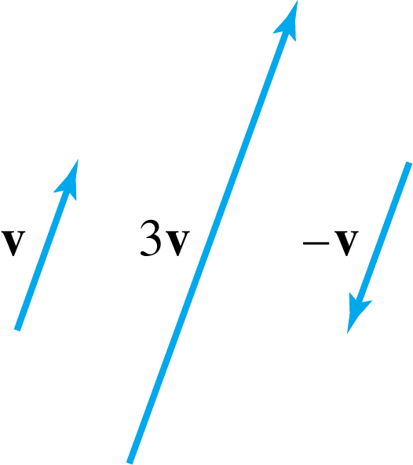

VECTOR SPACES AND SUBSPACES
See the following figure below. Show that V is a vector space.
Solution: The definition of V is geometric, using concepts of length and direction.
No xyz-coordinate system is involved.
An arrow of zero length is a single point and represents the zero vector.
The negative of v is v.
So Axioms 1, 4, 5, 6, and 10 are evident. See the figures on the next slide.

Slide 6
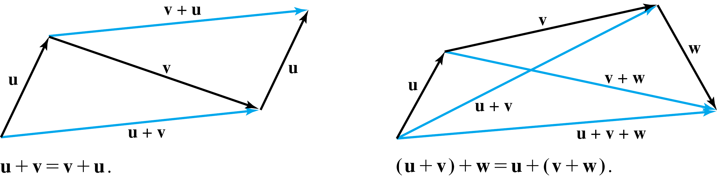
SUBSPACES
Definition: A subspace of a vector space V is a subset H of V that has three properties:
    The zero vector of V is in H.
    H is closed under vector addition. That is, for each u and v in H, the sum is in H.

Slide 7
SUBSPACES
    H is closed under multiplication by scalars. That is, for each u in H and each scalar c, the vector cu is in H.
Properties (a), (b), and (c) guarantee that a subspace H of V is itself a vector space, under the vector space operations already defined in V.
Every subspace is a vector space.
Conversely, every vector space is a subspace (of itself and possibly of other larger spaces).

Slide 8
A SUBSPACE SPANNED BY A SET
The set consisting of only the zero vector in a vector space V is a subspace of V, called the zero subspace and written as {0}.
As the term linear combination refers to any sum of scalar multiples of vectors, and Span {v₁,…,v_{p}} denotes the set of all vectors that can be written as linear combinations of v₁,…,v_{p}.

Slide 9
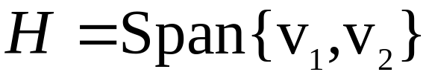
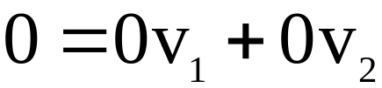
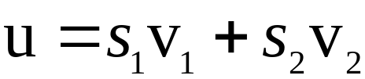
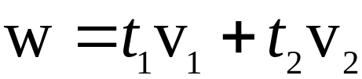
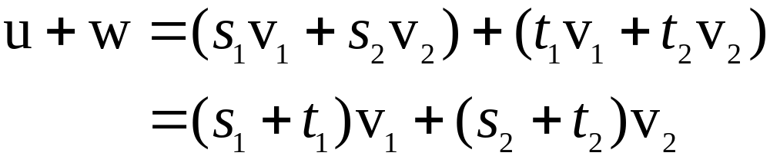
A SUBSPACE SPANNED BY A SET
Example 2: Given v₁ and v₂ in a vector space V, let
. Show that H is a subspace of V.
Solution: The zero vector is in H, since .
To show that H is closed under vector addition, take two arbitrary vectors in H, say,
and .
By Axioms 2, 3, and 8 for the vector space V,

Slide 10

A SUBSPACE SPANNED BY A SET
So is in H.
Furthermore, if c is any scalar, then by Axioms 7 and 9,
which shows that cu is in H and H is closed under scalar multiplication.
Thus H is a subspace of V.

Slide 11
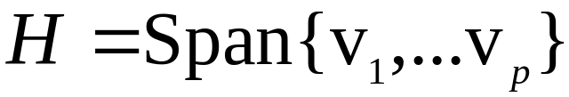
A SUBSPACE SPANNED BY A SET
Theorem 1: If v₁,…,v_{p} are in a vector space V, then Span {v₁,…,v_{p}} is a subspace of V.
We call Span {v₁,…,v_{p}} the subspace spanned (or generated) by {v₁,…,v_{p}}.
Give any subspace H of V, a spanning (or generating) set for H is a set {v₁,…,v_{p}} in H such that
.

